Slide 1



A UNIVERSITY CAMPUS SUFFOLK GAME

Slide 2
Roles Since Previous Milestone
Dean Leaks
  Project Management
  Shark Animation
  Additional Assets / UI
Roger Creyke
  Building the game engine
  Controls
  Game Refinement
Ryan Avent
  Character Animation
  Character Rendering
  Primary Game Assets
George Daters
  Menu System
  Snow Effect
  Shark AI

Slide 3
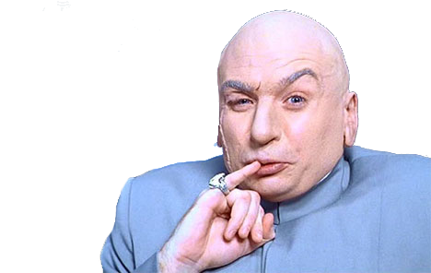
Progressometer
October
Vertical Slice
May

Slide 4
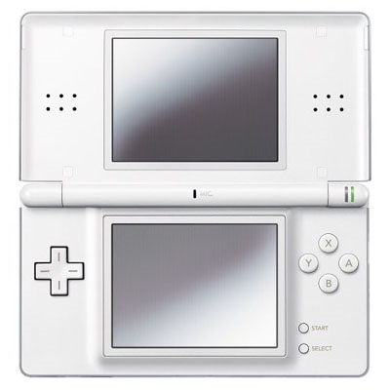
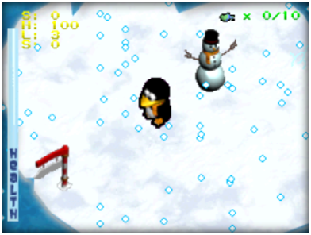


Slide 5
Project Plan

Slide 6
Programming

Slide 7
Programming Ctd.

Slide 8
Programming Ctd.

Slide 9
Design: Character Development

Slide 10
Design: Character Development

Slide 11
Shark Artificial Intelligence

Slide 12
Design: Additional Game Assets

Slide 13
Design: Level

Slide 14
Design: UI

Slide 15
Programming: Menus

Slide 16
Project: General Risks

Slide 17
Project: Risk Mitigation

Slide 18
Project: Technical Risks

Slide 19
Project: Risk Mitigation

Slide 20
Project: Playtesting

Slide 21
What next?

Slide 22


